Slide 2

0
3
Lesson 03
Counting III-Combination 1

Slide 3
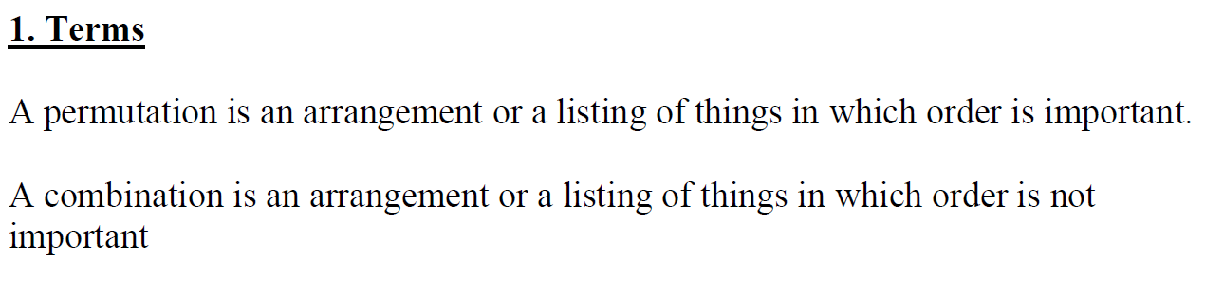
Lead in

Slide 4
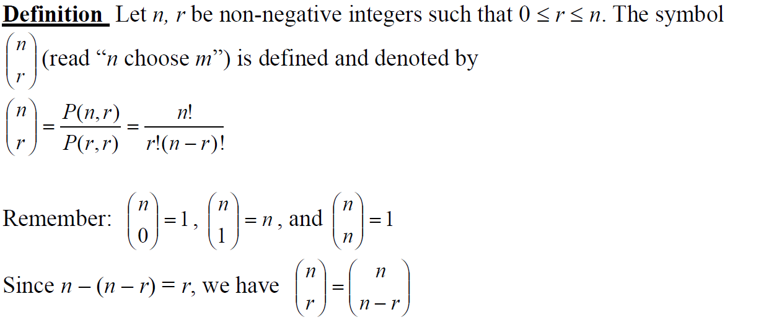
Lead in

Slide 5
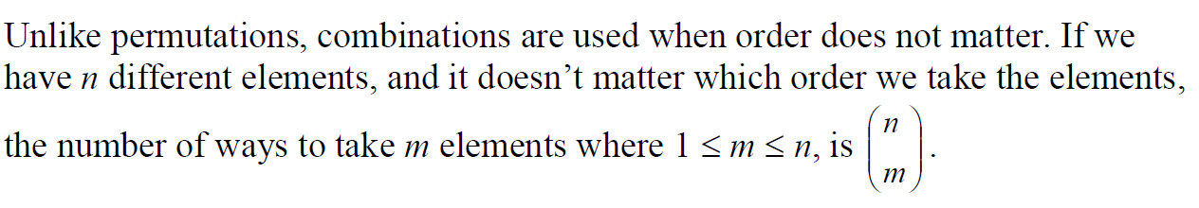
Lead in

Slide 6
Part 1
Combination Basic

Slide 7
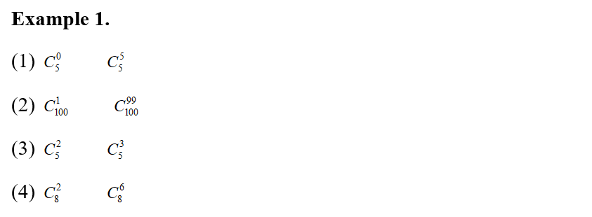

Example

Slide 8
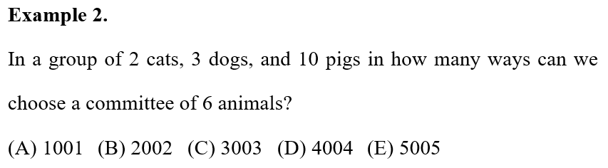
Example

Slide 9
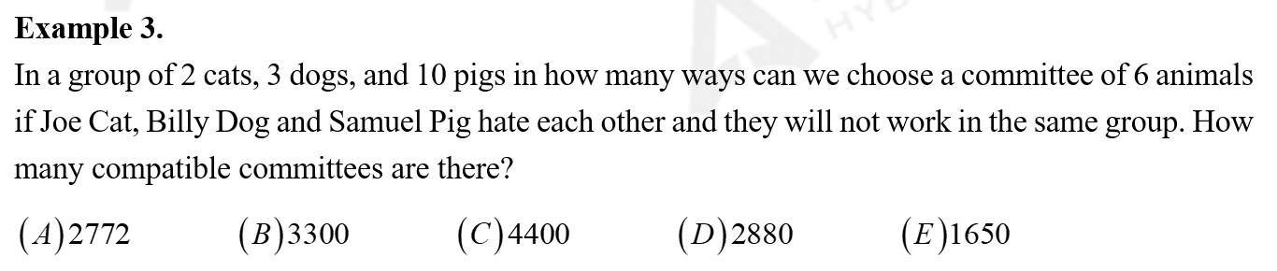
Example

Slide 10
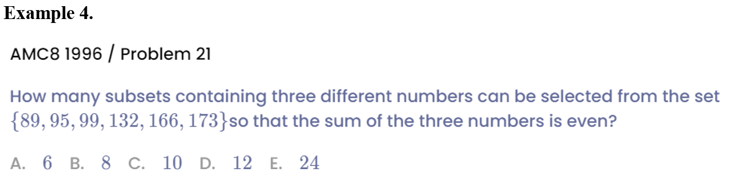
Example

Slide 11
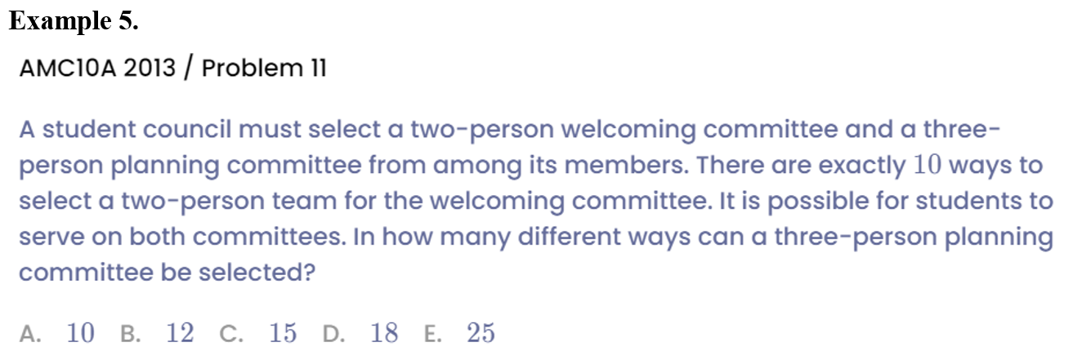
Example

Slide 12
Part 2
Problems of “Shaking Hands”

Slide 13
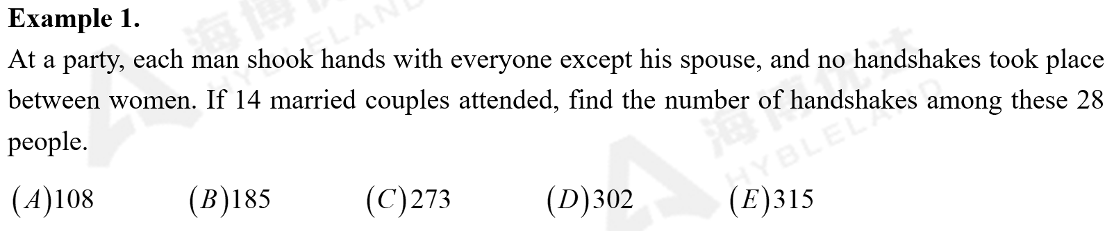
Example

Slide 14
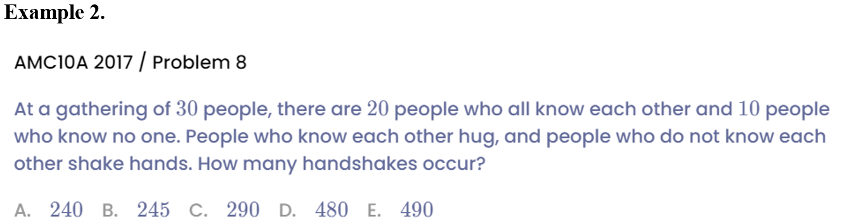
Example

Slide 15
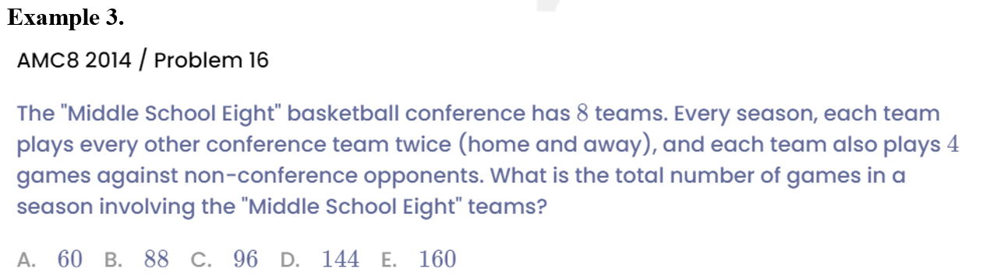
Example

Slide 16
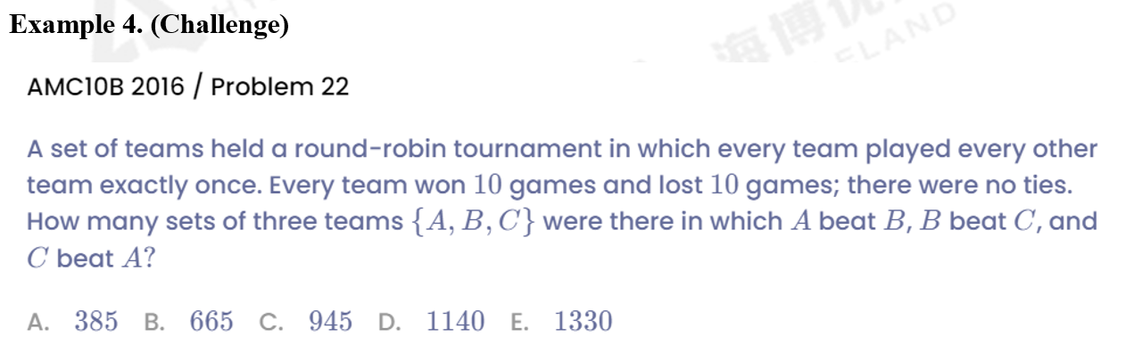
Example

Slide 17
Part 3
“Plug-in” Method

Slide 18
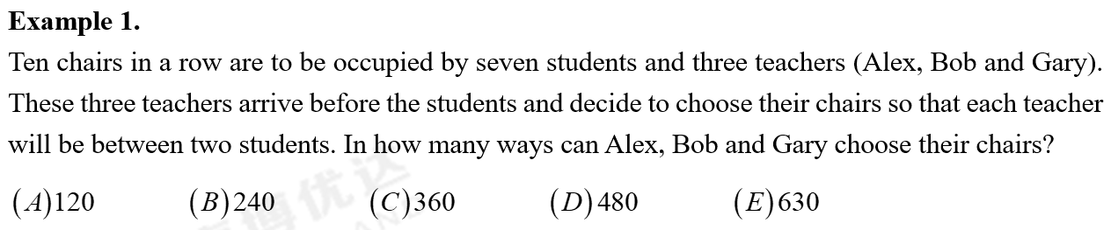
Example

Slide 19
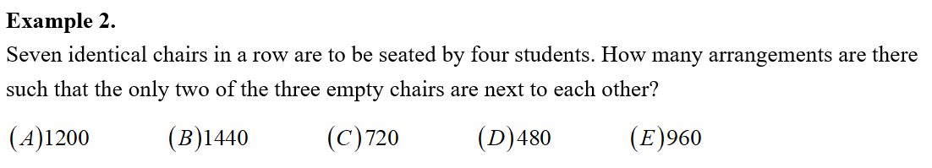
Example

Slide 20
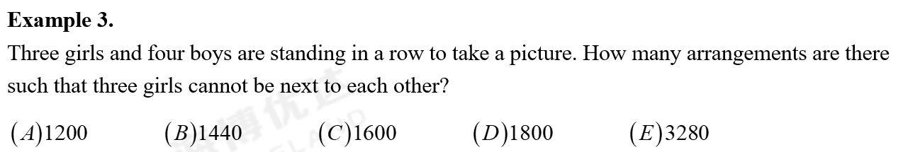
Example

Slide 21
Part 4
Increasing/Decreasing Number

Slide 22

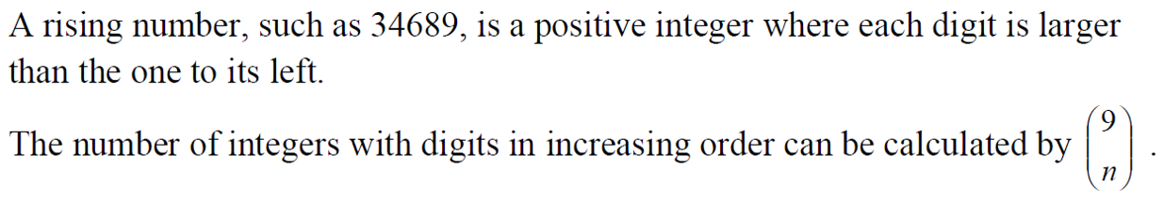
Lead in

Slide 23
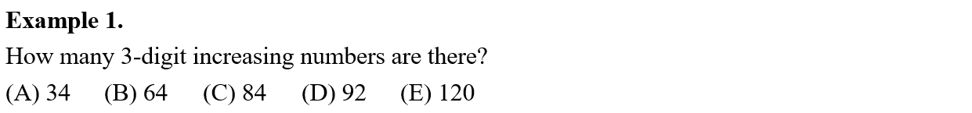
Example

Slide 24
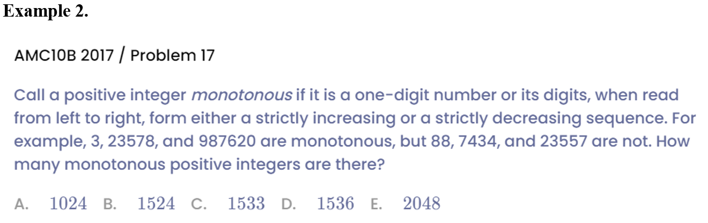
Example

Slide 25

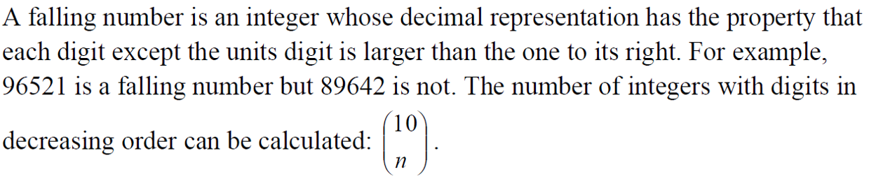
Lead in

Slide 26
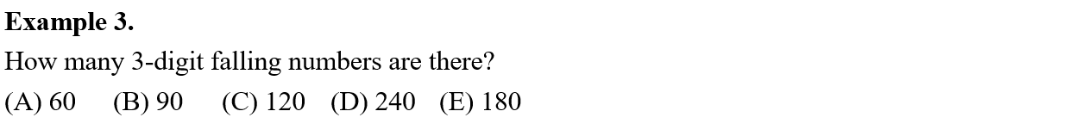
Example

Slide 27

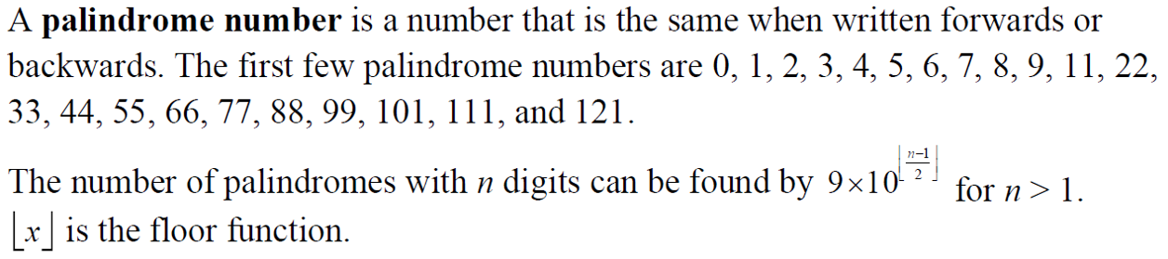
Example

Slide 28
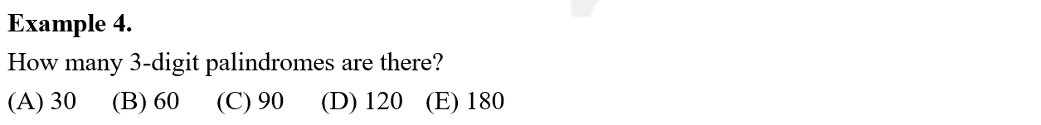
Example

Slide 29
See You Next Time!

